Slide 1
Chapter 4 (Part 2): Exploratory Factor Analysis

Slide 2
Reminder: Test Dimensionality
Dimensionality == Representation of a single attribute.
The general rule:
  Only one thing should be measured!
  Example: If measuring social anxiety, scores should only be affected by social anxiety!
Notes:
Representation of a single attribute:
The “score” from the bathroom scale must reflect only one physical dimension.
Similarly, the score obtained from a psychological test should represent only a single psychological feature or attribute.
The general rule:
Generally, though not always, to measure physical and psychological attributes, only a single attribute of the object or person is intended to be measured.
For instance, to measure social anxiety, the scores obtained should be affected only by social anxiety and not any other psychological attributes.
Combining scores:
Combining scores that are totally unrelated to each other yield no clear interpretation.
In other words, combining test scores of two independent physical or psychological scores gives no clear meaning.
Composite scores:
Some psychological tests include multiple questions or test items.
In such tests, the item responses are combined to reflect the psychological attribute(s) of interest—such scores are referred to as composite scores.
Composite scores ideally reflect only one dimension.
However, when the tests reflect more than one dimension, it leads to three important questions about the usage of these tests.

Slide 3

Notes:
Figure 4.2: Unidimensional test.

Slide 4

Multidimensional Tests with Correlated Dimensions.
Notes:
Figure 4.3: Multidimensional test with correlated dimensions (i.e., a higher order factor test).

Slide 5
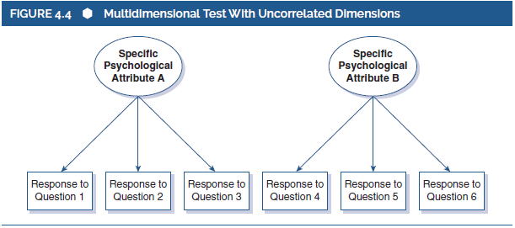
Multidimensional Tests with Uncorrelated Dimensions.
Notes:
Figure 4.4: Multidimensional test with uncorrelated dimensions.

Slide 6
Evaluating Test Dimensionality?
Factor analysis!
  Statistical tool for evaluating test dimensionality
Notes:
Third important dimensionality issue.
When the dimensionality issue and association between multiple dimensions are addressed, the third issue in hand is to understand the psychological meaning of each test dimension.
This is important because revealing the psychological attribute of each test dimension allows accurate interpretation and use of test’s dimensions.
Factor analysis: Factor analysis is a statistical tool used to evaluate test dimensionality.

Slide 7
Factor Analysis
Two main types:
  Exploratory factor analysis (EFA).
    Common easy (depends on who you ask), and used in the early stages
  Confirmatory factor analysis (CFA)
    Less common, conducted later
Notes:
The most common method of examination:
While methods such as cluster analysis and multidimensional scaling exist, factor analysis is more commonly used.
The method addresses important questions about test dimensionality.
Exploratory factor analysis (EFA):
Factor analysis is of two broad types, one of which is exploratory factor analysis (EFA).
EFA is common, easy conduct, and used in the early stages of the analysis.
Confirmatory factor analysis (CFA): Confirmatory factor analysis is the other stype of factor analysis and is less common when compared to EFA.

Slide 8
Why use Factor Analysis?
Alternate approach: Personal interpretation.
  Potential problems?
A better approach is to interpret empirical data.
  Looking for patterns in responding between test items.
  Items measuring the same dimension should be correlated
  Example: A participant should respond similarly to all questions on a personality test that measure “assertiveness”.
    if not, suggests that these questions might measure separate constructs
Notes:
Approach based on personal interpretation:
Earlier in the chapter, there was a six-item questionnaire that discusses different adjectives such as talkative, creative, assertive, and so on. The test results were based on the personal interpretations of the test users.
This approach, however, poses certain challenges while determining the structure of the questionnaire.
Interpretation of empirical data:
Using empirical data instead of personal interpretations is more preferred to determining the meaning of the test items.
The data collected from the test can then be fed into a software package to draw correlations between the test items and use the correlations to interpret the dimensions.
Table 4.1 illustrates the approach in the case of the six-item questionnaire.
Understanding the dimensionality:
Studying the interitem correlation (like Table 4.1), one will be able to understand the dimensionality of the test.
Also, set of weakly and strongly correlated items can be identified and the one with higher correlation represents a psychological dimension or “factor.”
Addressing the dimensionality questions:
By understanding the dimensionality, the three questions of dimensionality can be addressed.
Following the determination of dimensionality (unidimensional or multidimensional), the patterns of correlation between the sets are examined.
Next, the content of the items is examined to understand the the potential psychological meaning of the factor.
The above steps can be applied to Table 4.1 and this can be considered as a very basic factor analysis.

Slide 9
Looking at Correlations
 | Talkative | Assertive | Outgoing | Creative | Imaginative | Intellectual
Talkative | 1.00
Assertive | .66 | 1.00
Outgoing | .54 | .59 | 1.00
Creative | .00 | .00 | .00 | 1.00
Imaginative | .00 | .00 | .00 | .46 | 1.00
Intellectual | .00 | .00 | .00 | .57 | .72 | 1.00
Notes:
Table 4.1: (Hypothetical) correlation matrix for a two-factor set of items.

Slide 10
Looking at Correlations
 | Talkative | Assertive | Outgoing | Creative | Imaginative | Intellectual
Talkative | 1.00
Assertive | .66 | 1.00
Outgoing | .54 | .59 | 1.00
Creative | .00 | .00 | .00 | 1.00
Imaginative | .00 | .00 | .00 | .46 | 1.00
Intellectual | .00 | .00 | .00 | .57 | .72 | 1.00
Notes:
Table 4.1: (Hypothetical) correlation matrix for a two-factor set of items.

Slide 11
Problems w/ the Correlational Method
“eyeballing” correlations isn’t usually feasible
  Large datasets + lack of clarity == error
EFA simplifies the process
  Goal is to mathematically summarize and describe the way test items relate to each other
Notes:
Shortcomings of factor analysis:
The simple “eyeballing” approach of examining the pattern of hypothetical correlations does not work well with real data.
This is because of the largeness of the data as well as the lack of clarity that arises from the larger number of correlations.
A simple statistical procedure:
Since visually inspecting a large amount of data can be complex, exploratory factor analysis (EFA) which is a statistical procedure can be used to simply the process.
Researchers use EFA to examine the dimensionality of psychological measures and factor analysis to summarize and describe the way the items on a test relate to each other.

Slide 12
Factors
Factor analysis attempts to achieve parsimony by explaining the maximum amount of common variance in a correlation matrix using the smallest number of explanatory constructs/dimensions.
  These ‘explanatory constructs’ are called factors.
  Must specify number of factors when running the analysis!

Slide 13
Communality = 1
Variance of
Variable 3
Variance of
Variable 1
Variance of
Variable 2
Communality = 0
Variance of
Variable 4

Slide 14
Determining the Number of Factors (1 of 6)
Ways to determine number to extract
  Theory
  Kaiser criterion
  Scree Plots
  Parallel Analysis

Slide 15
Determining the Number of Factors (2 of 6)
Theory
  Usually you have an idea of the number of latent constructs you expect
  You made the scale that way
  Previous research

Slide 16
Determining the Number of Factors (3 of 6)
Kaiser criterion
  Note this is sometimes still used, but usually not recommended
  Old rule: extract the number of eigenvalues over 1
  New rule: extract the number of eigenvalues over .7

Slide 17
Determining the Number of Factors (4 of 6)
Eigenvalues:
  A mathematical representation of the variance accounted for by that grouping of items
Confusing part:
  You will see the same number of eigenvalues as you have items because they are calculated before extraction
  Only a few should be large

Slide 18
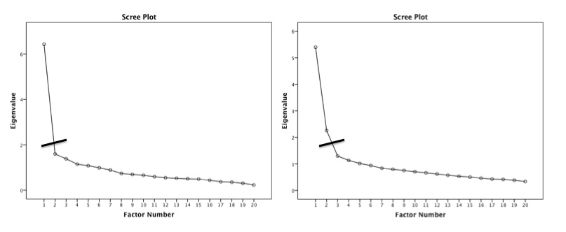
Determining the Number of Factors (5 of 6)
Scree plot – a graphical representation of eigenvalues
  Look for a large drop

Slide 19
Determining the Number of Factors (6 of 6)
Parallel Analysis – a statistical test to tell you how many eigenvalues are greater than chance
  Calculates the eigenvalues for your data
  Randomizes your data and recalculates the eigenvalues
  Then compares them to determine if they are equal

Slide 20
Simple Structure (1 of 10)
Fitting estimation = MATH that is used to determine factor loadings.
  How to pick?
  Depends on what your goal is for the analysis.
  Maximum likelihood is most commonly used method in psych

Slide 21
Simple Structure (2 of 10)
Rotation – rotation helps you achieve simple structure by increasing the communality between items
To aid interpretation: maximize the loading of an item on one factor while minimizing its loading on all other factor
  Orthogonal
  Oblique

Slide 22
Orthogonal
Oblique

Slide 23
Simple Structure (3 of 10)
Orthogonal – assumes factors are uncorrelated
  Rotates at 90º
  Means no overlap in variance between factors
  Not suggested for psychology

Slide 24
Simple Structure (4 of 10)
Oblique – assumes some correlation between factors
  Rotates at any degree
  Allows factors to overlap
  If factors are truly uncorrelated, you get the same results as orthogonal

Slide 25
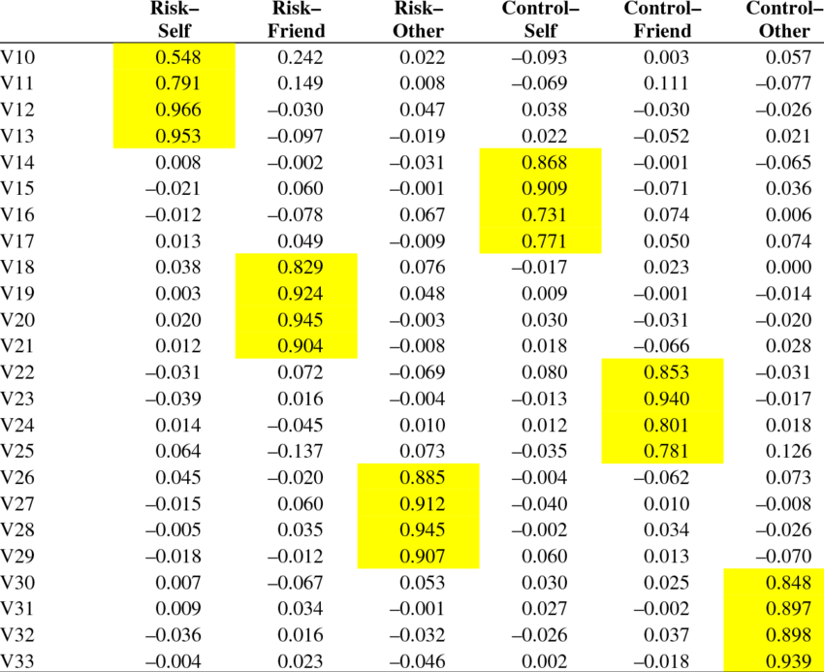
Simple Structure (5 of 10)
Loadings – the correlation between that item and the factors

Slide 26
Simple Structure (6 of 10)
What to look for:
  Items to load over .300
  Remember that r = .3 is a medium effect size that is ~10% variance
  You can use higher loadings to help cut out low loading questions, but really can’t go lower.

Slide 27
Simple Structure (7 of 10)
Loadings
  You want each item to load on one and only one factor
  Double loadings = indicate a bad item
  No loading = indicate a bad item

Slide 28
Simple Structure (8 of 10)
Loadings
  Factors with only one/two items loading onto it are considered unique
  You should consider eliminating that factor
  Remember three or four items per factor are suggested

Slide 29
Simple Structure (9 of 10)
What to do if bad items?
  In this step you might run several rounds
  Find the bad items, run the EFA/PCA again without them
Cross loadings?
  If there is a good theoretical reason, but generally not accepted

Slide 30
Simple Structure (10 of 10)
When are you finished?
  When all items have loaded adequately!

Slide 31
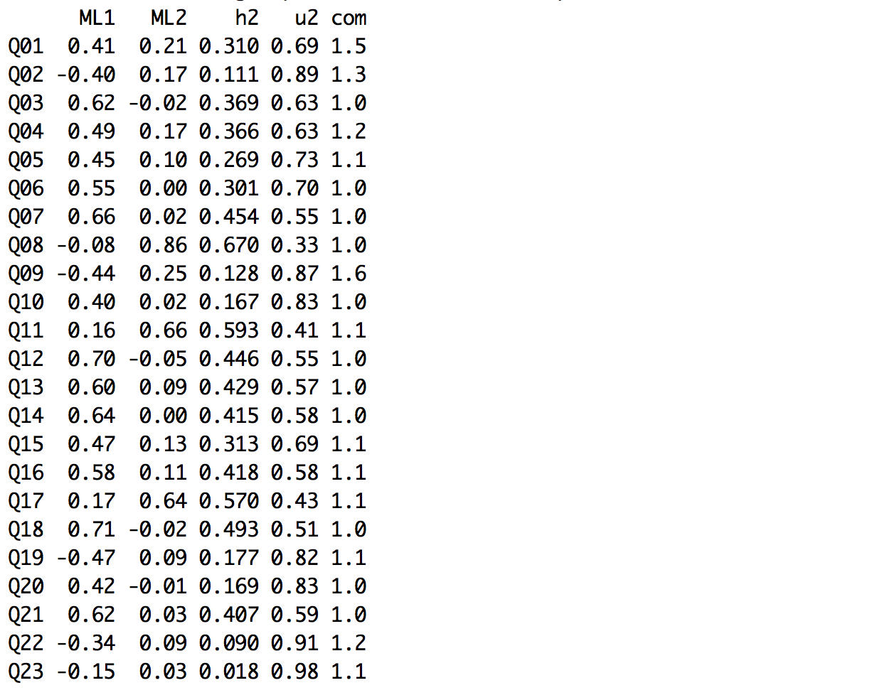
2. Simple Structure
ML1 = Factor 1
ML2 = Factor 2.
Which item(s) to remove?

Slide 32
Adequate solution (1 of 6)
So how can I tell if that simple solution is any good?
  Fit indices
  Reliability
  Theory

Slide 33
Adequate solution (2 of 6)
Fit indices – a measure of how well the rotated matrix matches the original matrix
Two types:
  Goodness of fit
  Residual statistics

Slide 34
Adequate solution (3 of 6)
Goodness of fit statistics – want large values, compares reproduced correlation matrix to real correlation matrix
Fit | Name | Good | Acceptable | Poor
NNFI/TLI | Non-normed fit index, Tucker-Lewis index | >.95 | >.90 | <.90
CFI | Comparative fix index | >.95 | >.90 | <.90
NFI | Normed fit index | >.95 | >.90 | <.90

Slide 35
Adequate solution (4 of 6)
Residual statistics – want small values, look at the residual matrix (i.e. reproduced – real correlation table)
Fit | Name | Good | Acceptable | Poor
RMSEA | Root mean square error of approximation | <.06 | .06-.08 | >.10
RMSR | Root mean square of the residual | <.06 | .06-.08 | >.10

Slide 36
Adequate solution (5 of 6)
Reliability – an estimate of how much your items “hang together” and might replicate
Cronbach’s alpha most common
  .70 or .80 is acceptable
Split-half reliability for big datasets
  Splits data in half, runs reliabilities, checks how similar they are

Slide 37
Interpreting Cronbach’s Alpha
Kline (1999)
  Reliable if α > .7
Depends on the number of items
  More questions = bigger α
Treat Subscales separately!
Remember to reverse score reverse phrased items!
  If not, α is reduced and can even be negative

Slide 38
Adequate solution (6 of 6)
Theory
  Do the item loadings make any sense?
  Can you label the factor?

